Slide 1


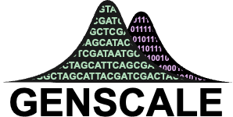

Optimization Framework For Phylogenetic Compression
Comité de Suivi Individuelle (1st year)
25 June 2025
Tam Truong
Dominique Lavenier, Thesis Director
Karel Břinda, Principal Scientific Supervisor
Pierre Peterlongo, Scientific Supervisor
Notes:
Good afternoon everyone, thank you for being here and today I would like to welcome everybody and present to you what I have been working on, it is about

Slide 2
Presentation Outline:
Background
Formation
PhD Research Presentation
Introduction
The Optimization Problem Formulation
Track 1: Pre-ordering
Track 2: Partitioning
Conclusion
Outcome and Next Steps

Slide 3
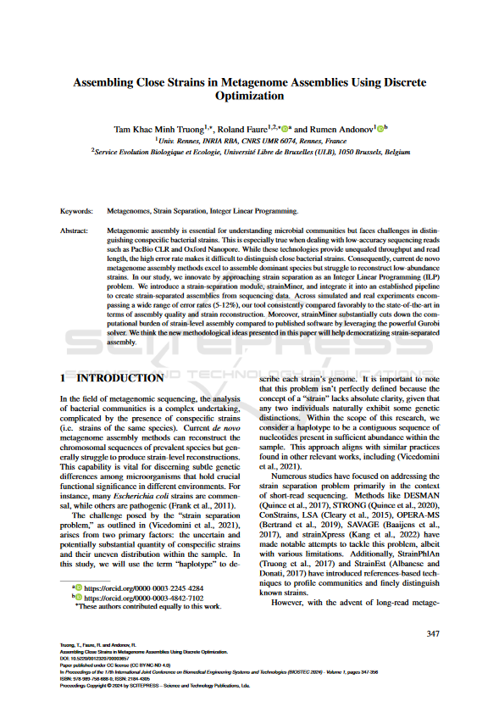
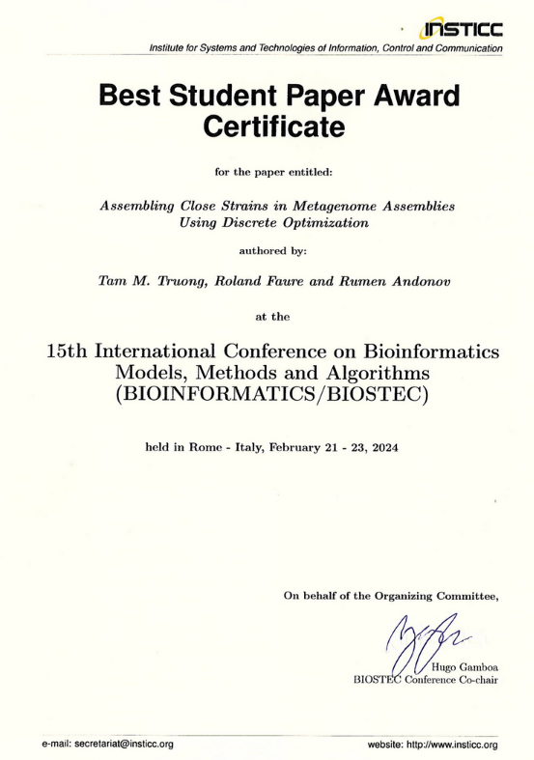
Backround: International & Multidisciplinary
2018-2021: Bachelor deg MIAGE – Rennes University
Multidisciplinary competences
Big data
Method development & researching
Master’s internships in bioinformatics
2021: Full-stack developer – Enedis, Paris
2021-2023: Double Master deg Data Science & Business:
Rennes & Aalto Univ (Finland)
2022 & 2023: 2 Internships at INRIA:
Optimization for Strains Seperation - Supervisor: R. Andonov
Start: Nov. 2024
PhD: Optimization for Phylogenetic Compression

Slide 4
Formation
First Year (at 7 month)
General training (51h)
Starthèse: Entrepreneurship
French language B1
Scientific training (Validation pending)
Conference attendance: SeqBim (2 days)
Various programmation training: Git, Good practices, Mooc Deep learning (~15h)
Plan: Second Year
General training
Ethic for Science
Scientific training (focus)
Scientific writing
Coferences
Teaching

Slide 5
PhD Research Presentation

Slide 6
Introduction

Slide 7
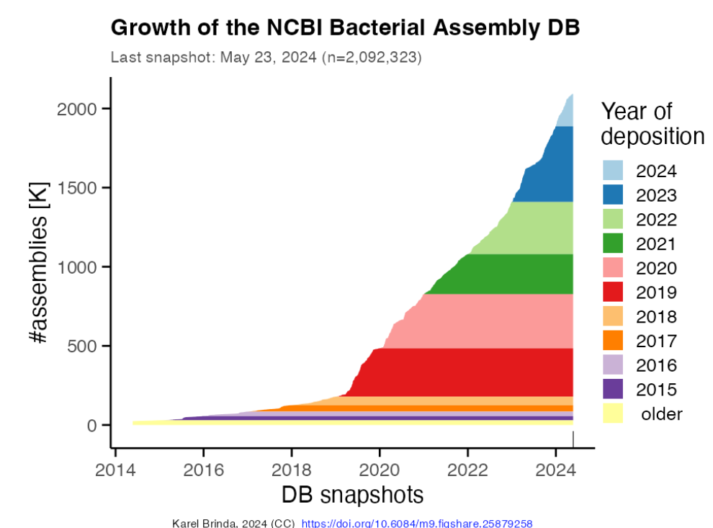
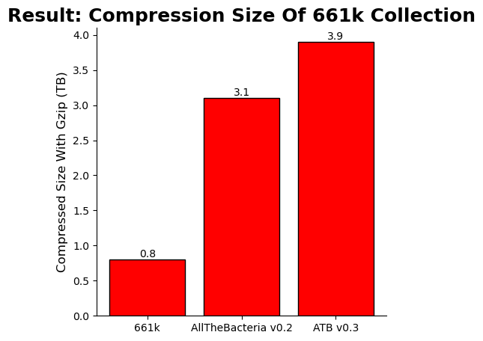
Motivation: Rapidly Growing Bacteria Genome Collections
Fast Growth Of Bacterial Genomes Data¹ (NCBI)
As of 2025: Multi-Terabytes Microbial Genome Collections
661k [2]
Nov. 2021
n = 661,405
AllThe Bacteria v0.2 [3]
Mar. 2024
n = 1,932,812 [3]
AllTheBacteria v0.3 [3]
Nov. 2024
n = 2,440,377 [3]
18 Jun 2025: ATB v0.4 with 330k new genomes
Next decade: Even larger collections (n = ~10⁷), higher diversity, …
Challenging: Efficient storage & analysis (indexing, searching)
Standard compression protocols based on gzip are not sufficient
Notes:
Bacterial genome databases are expanding rapidly, as shown in the snapshot on the right. Beyond individual genomes, we now have growing collections of genomes, which are becoming increasingly available and serve as a valuable resource for bacterial research. These collections are curated to ensure uniform processing of genomes, making them particularly useful for large-scale studies.
They are also growing at an impressive rate. For example, in the 661k collection, we have… All the bacterial…

Slide 8
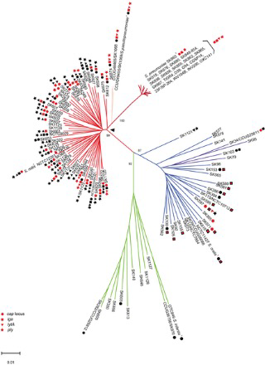
Phylogenetic Compression: New Method For Microbial Genomes Compression
Problem:
Compression is a widely studied problem but existing methods do not scale for modern genomes collection
Difficulty: Million-genome scale and complex redundancy structure of the collection.
Phylogenetic compression:
Key Idea: guiding of compression using evolutionary history to enhances local compressibility
Result: 1-2 order of magnitude improvement in compression size of genome collections
Notes:
And so we have a recent innovation, like it has been mentioned here a lot of time before, by Karel Brinda
Challenge: Compressing genomes efficiently is difficult/not easy because the data contains a lot of redundancy spread across different regions.
Key Idea: If we reorder genomes based on their evolutionary relationships, we can group similar sequences together, making compression more effective.

Slide 9
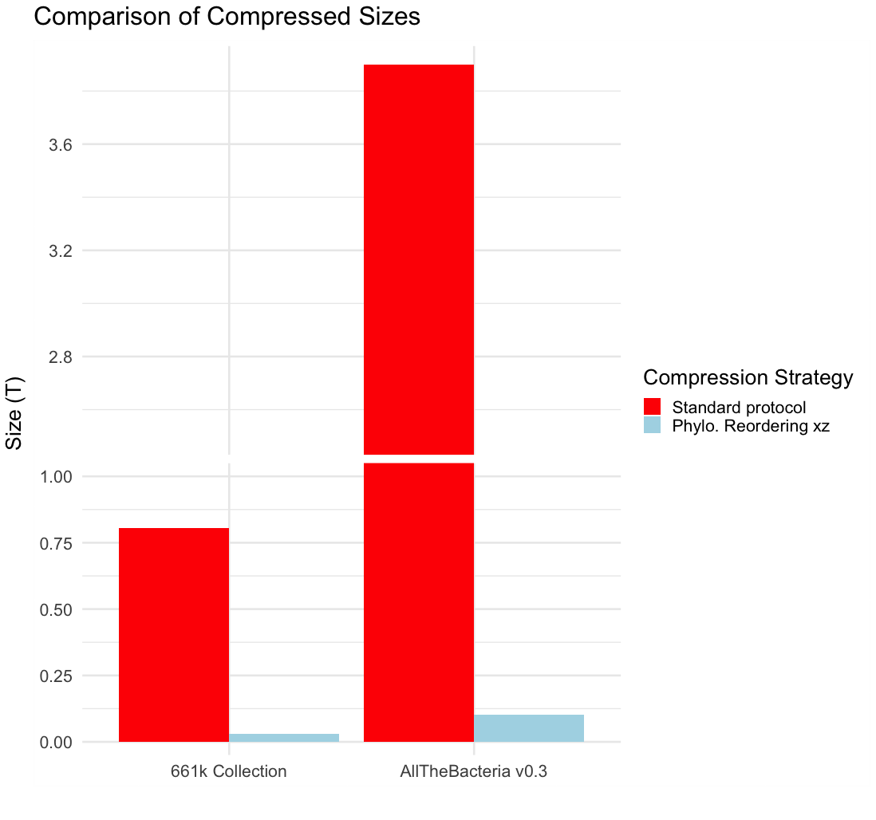
Phylogenetic Compression: Applications On Large Genomes Collections – 1-2 Orders Of Magnitude Reduction In Size
3,9T
Compression Size (T)
- Gzip
- MiniPhy
805G
29G
102G
661k [2]
AllTheBacteria v0.3 [3]
➔ Core compression technique for AllTheBacteria, currently the largest microbial genomes collection
Notes:
Phylogenetic comp reduced it down to respectively
The resulting improvement with the use of phylogenetic compression, specifically MiniPhy, shows a significant advancement in data compression. This method achieves lossless compression that improves by one to three orders of magnitude compared to the standard protocol, offering a more efficient way to handle large genomic datasets while maintaining data integrity.

Slide 10
Phylogenetic compression intrinsics: Two steps of reordering in Phylogetic Compression
Level 1 : Preordering via Species-based batching
Level 2 : Within-batch tree-based ordering
(left to right according to a phylogeny)
Collection of genomes
Species clustering
Followed by compression using a low-level tool using xz
Implemented in MiniPhy (github.com/karel-brinda/miniphy)
Notes:
In practice, phylogenetic compression involves two main steps. Step one is phylogenetic batching, which serves as the starting point of my PhD. In this step, genomes are grouped based on their phylogenetic relationships to improve the efficiency of compression. Step two is phylogenetic reordering, where genomes within each batch are reordered to further enhance the compression process.

Slide 11

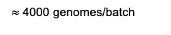
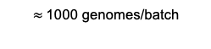
Level 1 : Batching (current state of the art via species & accessions)
MiniPhy’s default strategy: sort by submission time (accession number)
INPUT:
Collection of genomes
Species cluster 1
S1
S1
S1
Species clustering
Batching
S2
S2
S3
Dustbin:
Group genomes from small cluster
Sort the genomes lexicographically
Split big clusters into batches
$≈$4000 genomes/batch
S2
S3
Species form clusters in public databases
Split dustbin into batches
Sequencing data is typically uploaded together
i.e. genomes with nearby accession numbers are likely related.
$≈$1000 genomes/batch
1 – SAM029385
2 – SAM029386
3 – SAM029387
…
3999 – SAM033384
4000 – SAM033385
4001 – SAM033386
…
Parameters (Constraints):
Max batch size
Max dustbin size
Dustbin threshold (clusters go to dustbin)

Slide 12
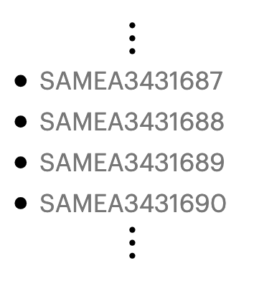
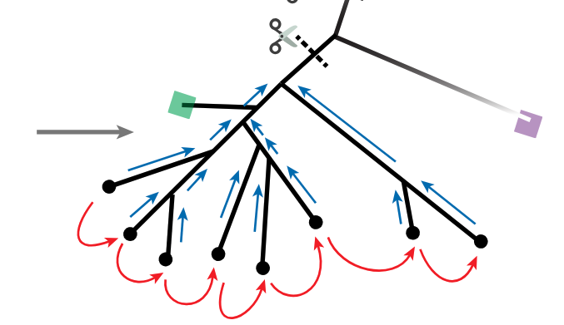
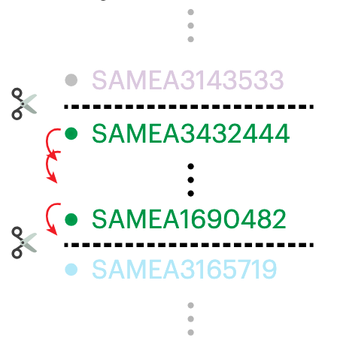
Level 2 : Within-batch tree based ordering (current state of the art, in MiniPhy via Attotree)
Attotree (github.com/karel-brinda/attotree) is used for Phylogenetic Inference
Highly efficient but scalable only to small to mid-size batches

Slide 13
Limitation: Phylogenetic batching currently unable to adjust to target applications
No formalization of batching as an optimization problem.
Batching are not suitable for hardware specific target application.
Heavily dependent on metadata for an approximative input order
We want
Constraints on:
Uncompressed sizes
Compressed sizes
Number of genomes
We want
Search on GPUs or for processing-in-memory (PIM) architectures
We want
Independence on metadata (accession numbers, species labels)

Slide 14
My Work

Slide 15
The Optimization Problem Formulation
For Phylogenetic Compression Batching

Slide 16
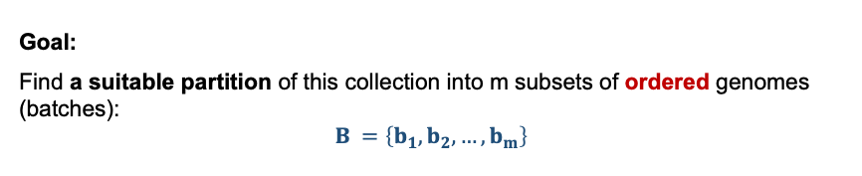
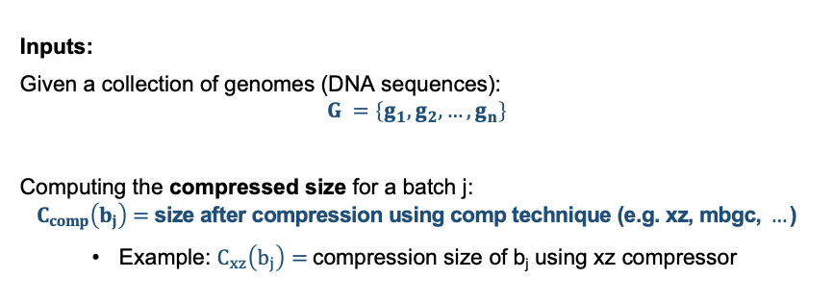
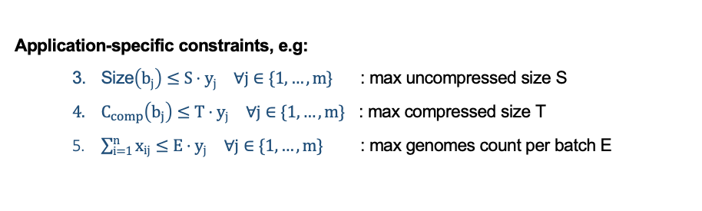
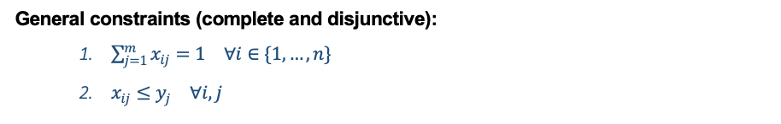
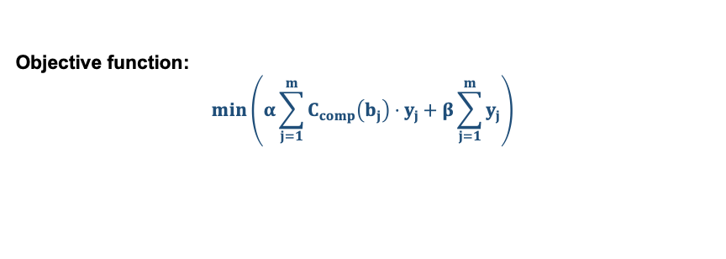
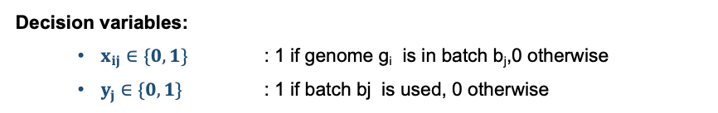
Formulation of the batching optimization problem for phylogenetic compression
Inputs:
Given a collection of genomes (DNA sequences):
$$G =\left\{g_{1},g_{2},…,g_{n}\right\}$$
Computing the compressed size for a batch j:
$$C_{comp}\left(b_{j}\right)=\text{siz}\text{e} \text{after} \text{compression} \text{using} \text{comp} \text{technique}\text{ (}\text{e}\text{.}\text{g}\text{. }\text{xz}\text{, }\text{mbgc}\text{, }…\text{)}$$
Example: $C_{xz}\left(b_{j}\right)=$compression size of b_{j} using xz compressor
Objective function:
$$\min\left(α\sum_{j=1}^{m}{C_{comp}\left(b_{j}\right)}⋅y_{j}+β\sum_{j=1}^{m}{y_{j}}\right)$$
Minimize total compressed batch sizes
Minimize the number of batches
Goal:
Find a suitable partition of this collection into m subsets of ordered genomes (batches):
$$B =\left\{b_{1},b_{2},…,b_{m}\right\}$$
General constraints (complete and disjunctive):
$\sum_{j=1}^{m}{x_{ij}}=1 ∀i∈\{1,…,n\}$
$x_{ij}≤y_{j} ∀i,j$
Application-specific constraints, e.g:
Size$\left(b_{j}\right)≤S⋅y_{j} ∀j∈\{1,…,m\}$ : max uncompressed size S
$C_{comp}\left(b_{j}\right)≤T⋅y_{j} ∀j∈\{1,…,m\}$ : max compressed size T
$\sum_{i=1}^{n}{x_{ij}}≤E⋅y_{j} ∀j∈\{1,…,m\}$ : max genomes count per batch E
Decision variables:
$x_{ij}∈\{0,1\}$ : 1 if genome g_{i} is in batch b_{j},0 otherwise
$y_{j}∈\{0,1\}$ : 1 if batch bj is used, 0 otherwise

Slide 17
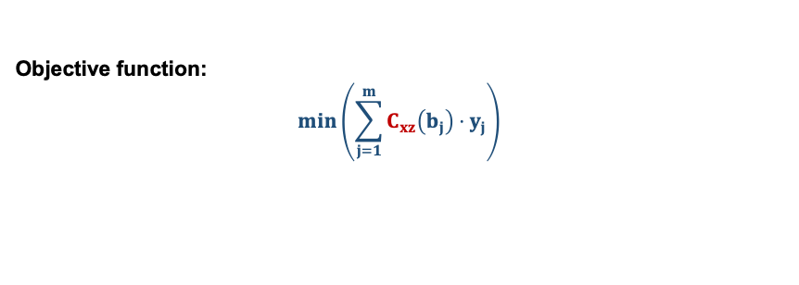
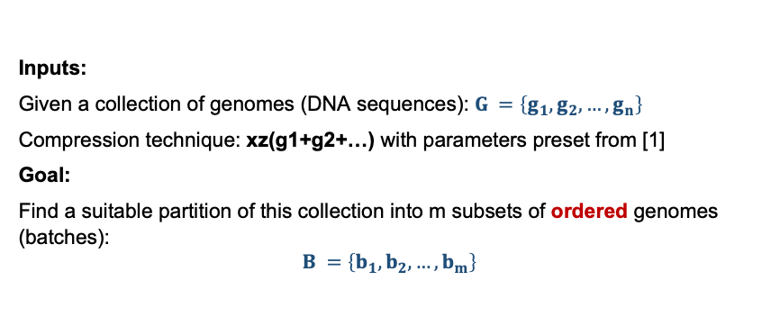
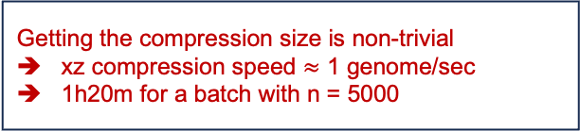
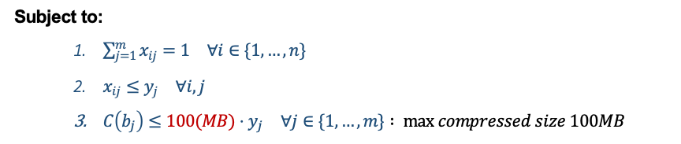
Scenario: max bound on per batch compressed size (motivated by internet transmission)
Inputs:
Given a collection of genomes (DNA sequences): $G =\left\{g_{1},g_{2},…,g_{n}\right\}$
Compression technique: xz(g1+g2+…) with parameters preset from [1]
Goal:
Find a suitable partition of this collection into m subsets of ordered genomes (batches):
$$B =\left\{b_{1},b_{2},…,b_{m}\right\}$$
Non linear objective function
Different genome order leads to different compression size
Objective function:
$$\min\left(\sum_{j=1}^{m}{C_{xz}\left(b_{j}\right)}⋅y_{j}\right)$$
Getting the compression size is non-trivial
xz compression speed $≈$ 1 genome/sec
1h20m for a batch with n = 5000
Subject to:
$\sum_{j=1}^{m}{x_{ij}}=1 ∀i∈\{1,…,n\}$
$x_{ij}≤y_{j} ∀i,j$
$C\left(b_{j}\right)≤100(MB)⋅y_{j} ∀j∈\{1,…,m\}$ $: max compressed size 100MB$

Slide 18
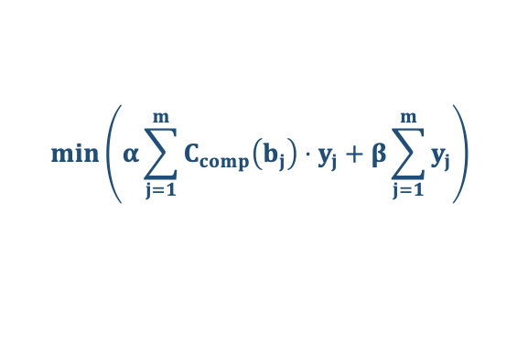
The Two Tracks Of My Work: Preordering & Partitionning
$$\min\left(α\sum_{j=1}^{m}{C_{comp}\left(b_{j}\right)}⋅y_{j}+β\sum_{j=1}^{m}{y_{j}}\right)$$
Difficult to solve in full generality
The goal of my PhD: develop a heuristic approaches
1. Phylogenetic Pre-ordering Of Genomes
2. Order-based Genome Batching

Slide 19
Recap and work in progress
Axis 1:
Preordering genome phylogenetically using heurisitic approach
Comprehensive and reproducible results
Python package
Axis 2:
Bin packing
Related work: Bin packing in bioinformatics
Bin packing with overlapping items
Model formulation: kmers bin packing

Slide 20
Axis 1: Phylogenetic Pre-ordering Of Genomes

Slide 21
Problem: Per species phylogenetic preordering without using accession number
INPUT:
Collection of genomes
Species 1
S2
OUTPUT (For each cluster):
An ordered set of genomes
Given:
Species clusters
Species clustering
S3
Problem:
Species – based pre-ordering of genomes at scale.
Difficulty:
Lacking scalable methods for mordern collections (>10⁵ genomes)

Slide 22
Methods based on size of species clusters
Species 1
S2
S3
Small to mid-size clusters:
State of the art methods is sufficient
(Mash, quicktree,…)
Large clusters:
Require new scalable method
Skeleton-based-tree

Slide 23
Method 1: Standard phylogenetic tree inference with Attotree
INPUT:
Collection of genomes
Species 1
S2
Species clustering
Infere phylogenetic tree with Attotree [1]:
Distance estimation (Mash) + Neighbor joining algorithm (Quicktree)
S3
Attotree
Challenging for large clusters due to Quicktree - O(n³)
In modern collection, species cluster with > 100k genomes would requires days of computation

Slide 24
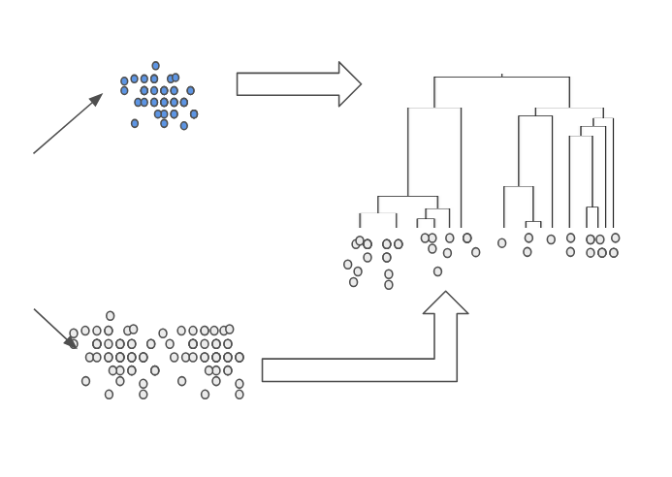
Method 2: Skeleton-tree Based Pre-ordering
Reference genomes
(fraction of the cluster)
Skeleton tree
Attotree
Large cluster
Ordered set of genomes
Nearest-neighbor placement with Mash
Remaining genomes

Slide 25
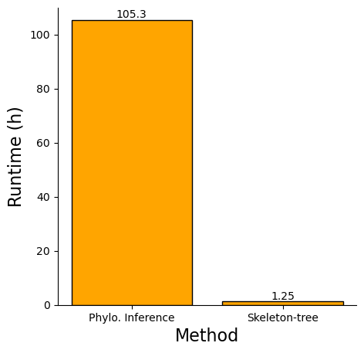
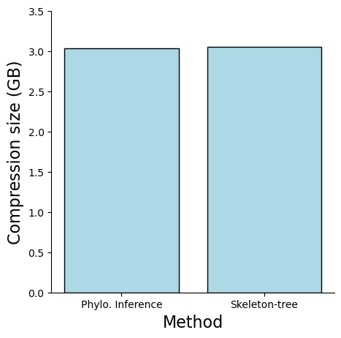
Initial result: Benchmark with E. coli from 661k collection
Setup:
Dataset: E. Coli cluster from 661k
Number of genomes: 89136
Methods compared:
Attotree (default setting)
Skeleton-tree based with 10% reference genomes
Run on Mac M4 with 10 cores
Significantly faster while having similar compression result
3.03
3.04
(need to update this bar using same setting as with new experiments)
Runtime (h)
Size (GiB)
Phylo. Inference
Skeleton-tree-based
Compression size comparison
Runtime comparison

Slide 26
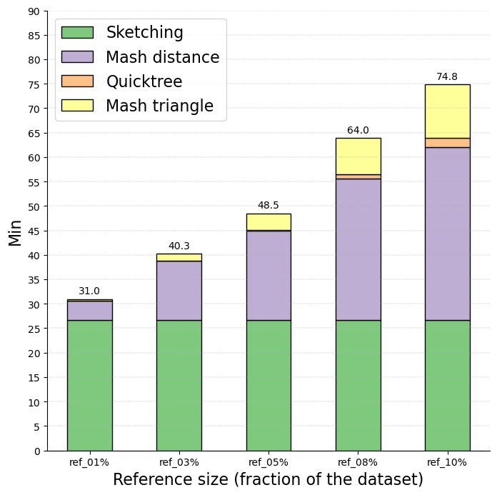
Example: Benchmark with E. coli – different reference genomes percentage, runtime by individual step
Attotree
Attotree with sketch size 10000
NN placement with sketch size 1000
The higher the number of reference genomes, the more impactful the runtime of phylogenetic tree inference on the total runtime
Number of calculation for NN placement:
1%: 80 x 10⁶
3%: 231 x 10⁶
5%: 377 x 10⁶
8%: 585 x 10⁶
10%: 715 x 10⁶
NN placement
1%
(891 genomes)
3%
(2674 genomes)
10%
(8914 genomes)
*Runtime will could change slightly in the future with new workflow implementation
5%
(4457 genomes)
8%
(7131 genomes)
*Runtime using 10 cores, on MacOS M4

Slide 27
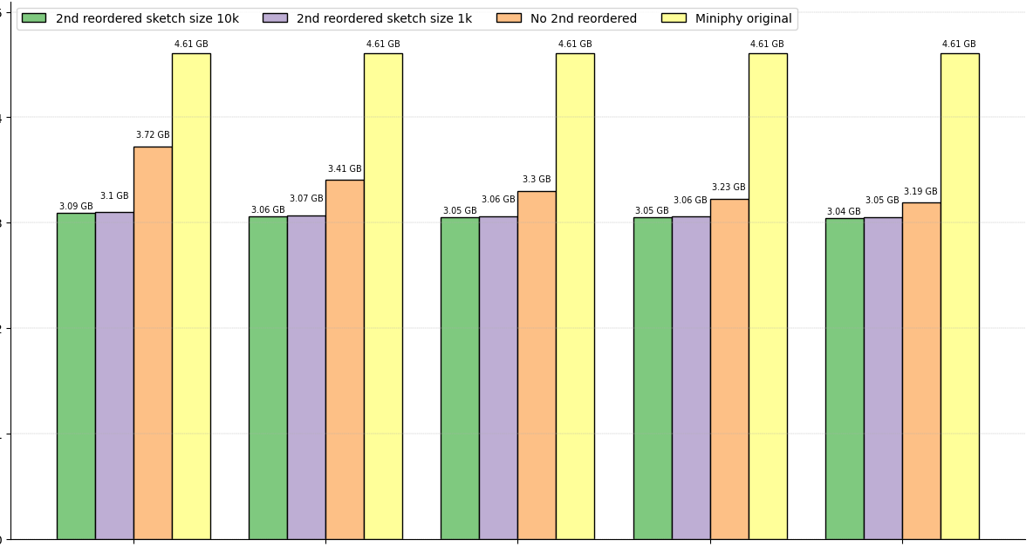
Example: Benchmark with E. coli – different reference genomes percentage, compression size, different within batch reordering method
Within batch reordering (2nd reordering) improve compression size
Sketch size has minimal effect on improving compression
Size (GB)
The higher the percentage of selection for reference genomes, the lower the improvement impact of 2nd reordering
No significant improvement in compression results for reference genomes of >5%
1%
(891 genomes)
3%
(2674 genomes)
5%
(4457 genomes)
8%
(7131 genomes)
10%
(8914 genomes)

Slide 28
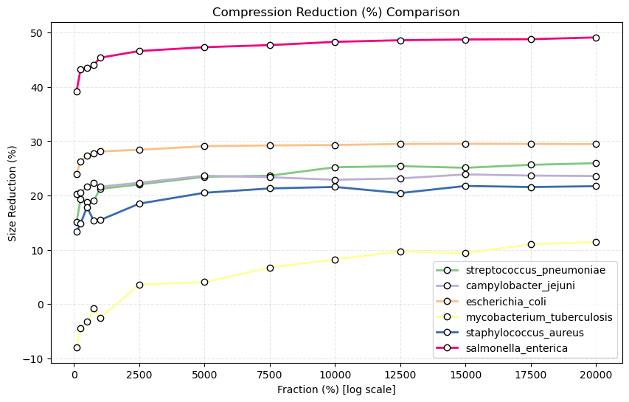
Result: different splitting schemes with different species – size reduction

Slide 29
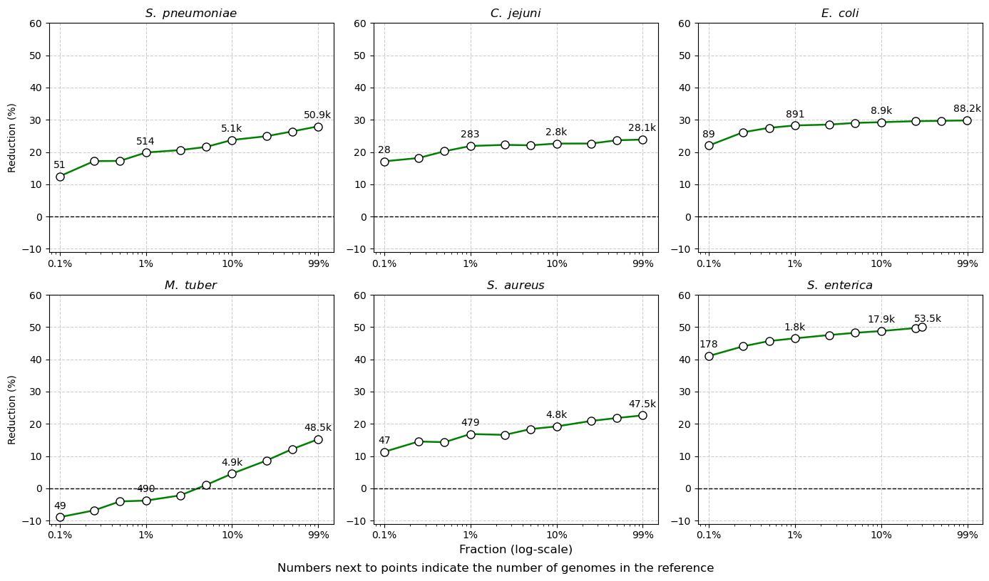
Result: different splitting schemes with different species – size reduction

Slide 30
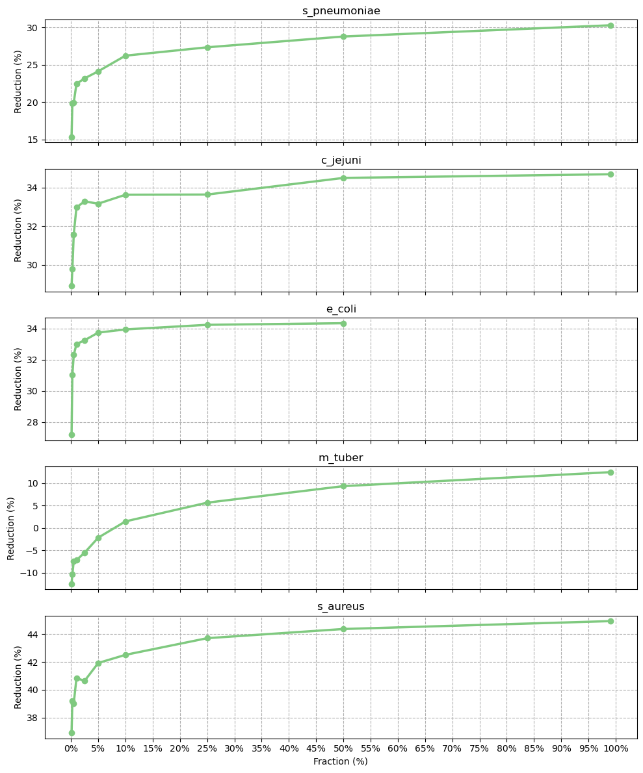
Result: different fraction with different species – reduction percentage

Slide 31
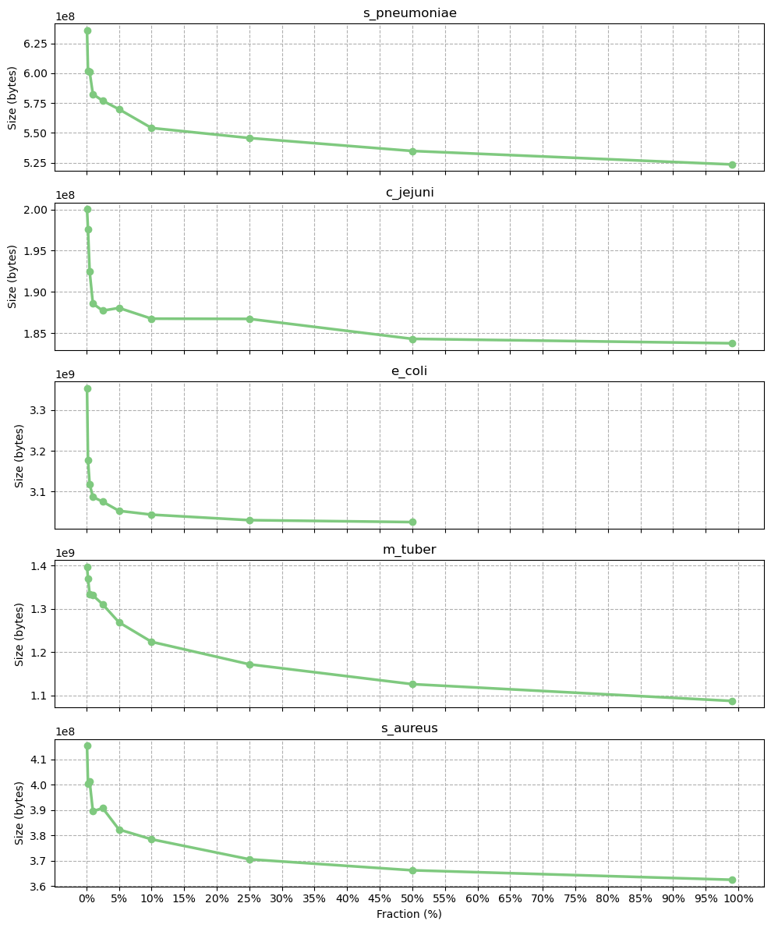
Result: different fraction with different species – real size

Slide 32
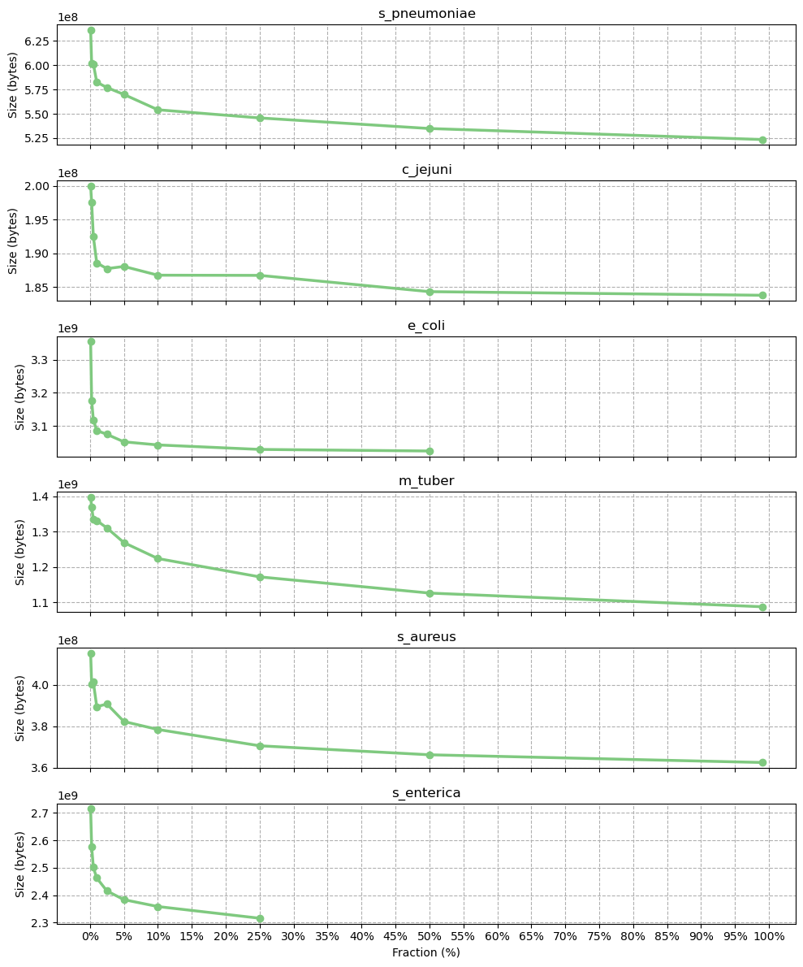

Slide 33
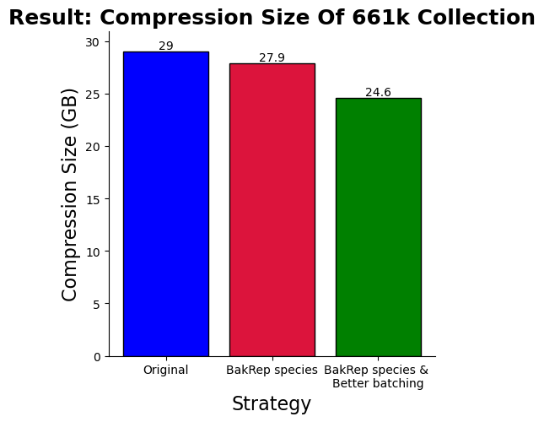
Experiment: Application to the whole 661k collection
Setup:
Dataset: 661k [1]
One large cluster:
S. enterica (180k genomes)
Compression results compared:
Original MiniPhy (Accession)
Original MiniPhy with new MetaData [2]
New strategy with new MetaData
 | Original | New
S. enterica | 4.6 | 3.8
E. coli | 4.3 | 3.0
S. pneumoniae | 0.7 | 0.5
Dustbin | 10.9 | 10.6
Compression size of
3 most highly sampled species & dustbin [GB]
Original Miniphy
Orig Miniphy
+
New metadata
New Strategy
+
New metadata
15% reduction in compression size compared to using accession number

Slide 34
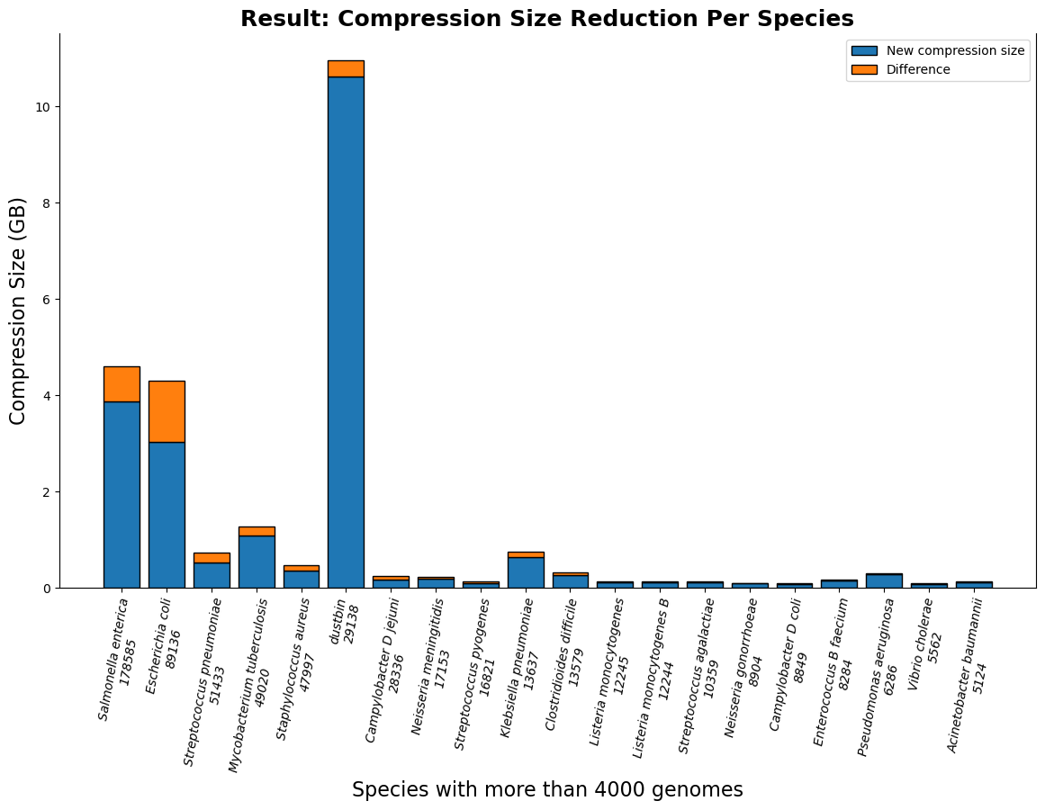
Result (661k) species-wise: per species absolute compressed size reduction
Clusters with more than 4000 genomes

Slide 35
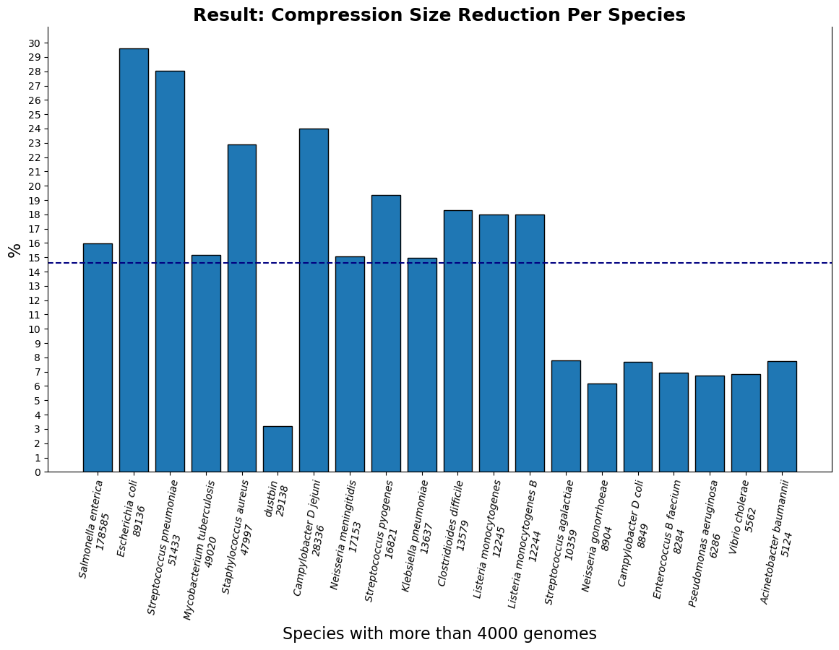
Result (661k) species-wise: per species relative compressed size reduction
Clusters with more than 4000 genomes

Slide 36
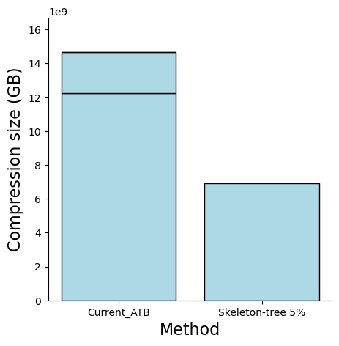
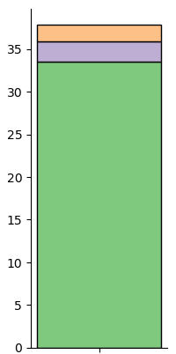
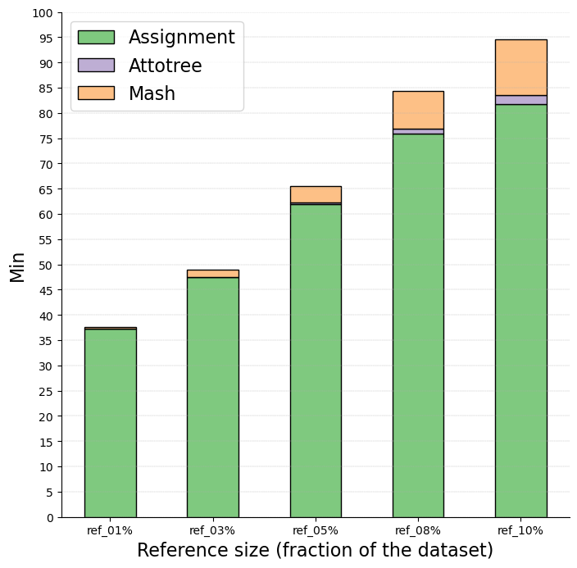
Experiment: Scaling up to AllTheBacteria – S. enterica
14.67 G
37.85h
Setup:
Dataset: AllTheBacteria [1]
S. enterica (644699 genomes)
Reference genomes at 5% (32235)
Number of calculation for assignment: 19x10⁹
Incr. update 1
1.99h
2.45 G
2.31h
33.55
6.91 G
This can be reduce using a smaller number of reference genomes i.e. 1%: ~4.1x10⁹ calculations
Size (GB)
Hour
v0.2
12.22 G
AllTheBacteria releases new genomes by incremental update, which is essentially a genomes collection by itself.
The ATB total size here is the sum of S.enterica batche sizes from 2 updates.
Placement
Quicktree
Mash triangle
AllTheBacteria
Skeleton-tree-based
(5%)
Compression size comparison
Runtime
Using 10 cores Mac M4
Notes:
ATB

Slide 38
What is the smallest possible genomes selection for reference tree that ensures a good compression size?
Hypothesis: Set of reference genomes with higher diversity would lead to better compression result

Slide 39
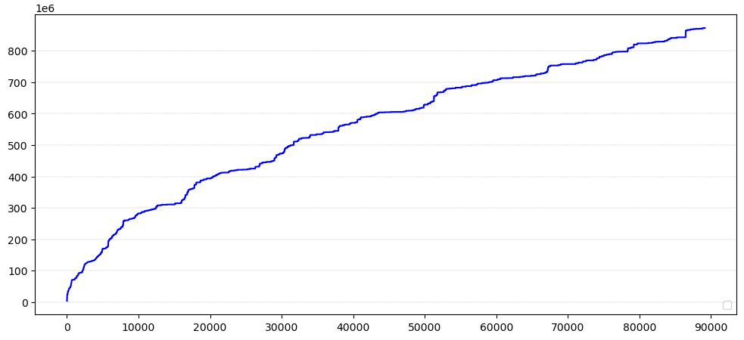
What is the smallest possible genomes selection for reference tree that ensures a good compression size?
Hypothesis: Set of reference genomes with higher diversity would lead to better compression result
Cumulative distinct kmers estimation – E.coli 661k – accession order
Distinct kmers count
Number of genomes

Slide 40
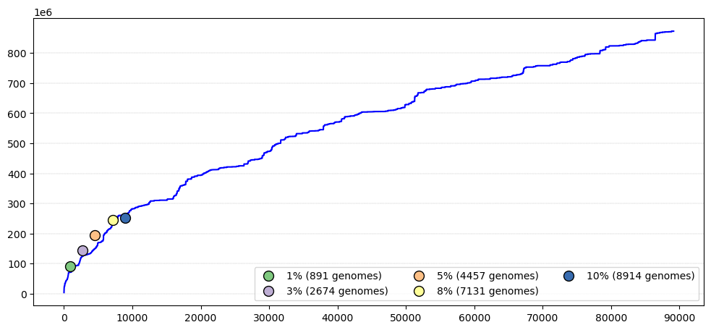
What is the smallest possible genomes selection for reference tree that ensures a good compression size?
Hypothesis: Set of reference genomes with higher diversity would lead to better compression result
Cumulative distinct kmers estimation – E.coli 661k – accession order
Distinct kmers count
Number of genomes

Slide 41
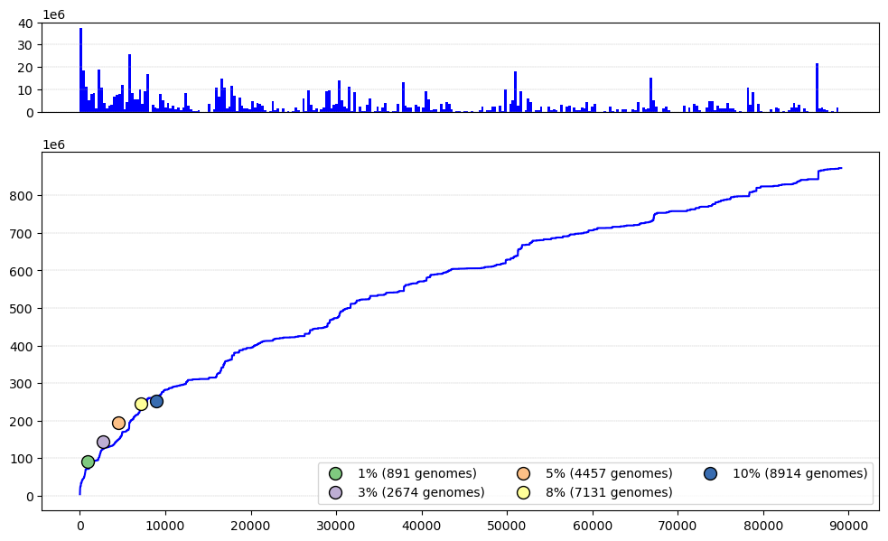
What is the smallest possible genomes selection for reference tree that ensures a good compression size?
Increases in distinct kmers count of each genomes
Select genomes that increase the distinct kmers count
Distinct kmers count
Number of genomes

Slide 42
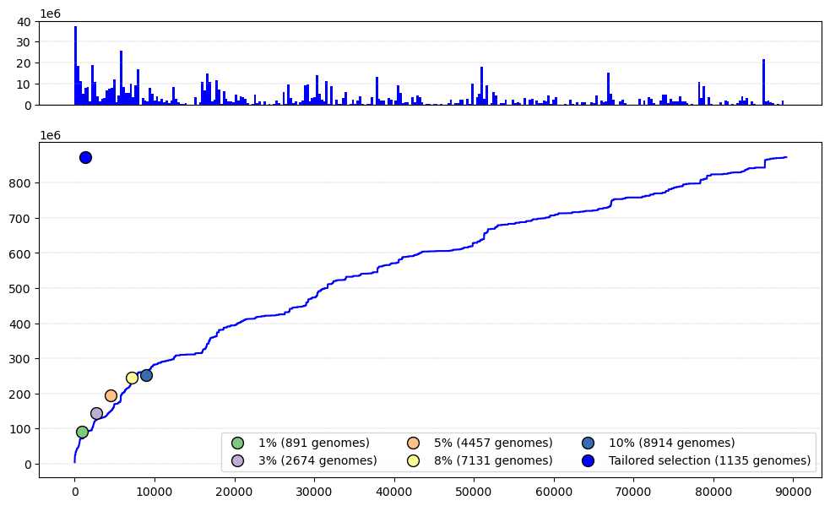
What is the smallest possible genomes selection for reference tree that ensures a good compression size?
Increases in distinct kmers count of each genomes
1135 genomes with distinct kmer count = all
Distinct kmers count
Number of genomes

Slide 43
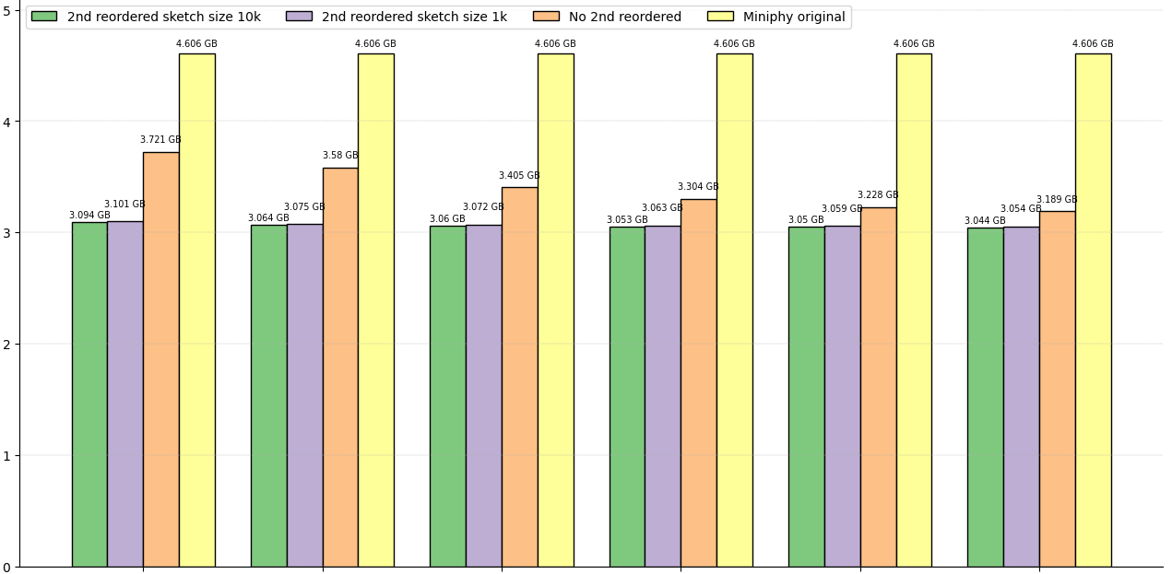
Experiment: compression result of tailored reference genomes selection
Size (GB)
1%
Tailored
3%
5%
8%
10%

Slide 44
Axis summary:
Skeleton-tree-based method is significantly faster and achieves comparable result.
Most of the compression improvement comes from dominant cluster.
The dustbin group shows the least relative size reduction.

Slide 45
Axis 2: Order-based Genome Batching

Slide 46
Bin Packing For Genomic Data

Slide 47
Introduction & motivation

Slide 48
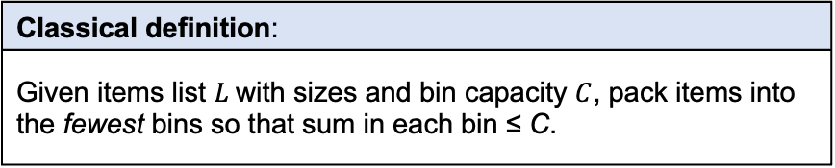

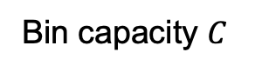
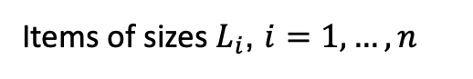
Bin packing: a classical and historically relevant optimization problem
Items of sizes $L_{i}$, $i=1,…,n$
Classical definition:
Given items list $L$with sizes and bin capacity $C$, pack items into the fewest bins so that sum in each bin ≤ C.
Bin capacity $C$
Historical contexts & applications
NP-hard, decision version NP-complete. Research began early 1970s: Ullman (1971), Johnson (1973–74), Garey et al. (1972–76). Recent survey: Coffman et al. (2013) Applications: logistics, computer systems, scheduling, Virtual Machine resource allocation Applications in bioinformatics: DREAM-Yara, HIBF, COBS
Pack
Pack into minimum bins $B$.

Slide 49
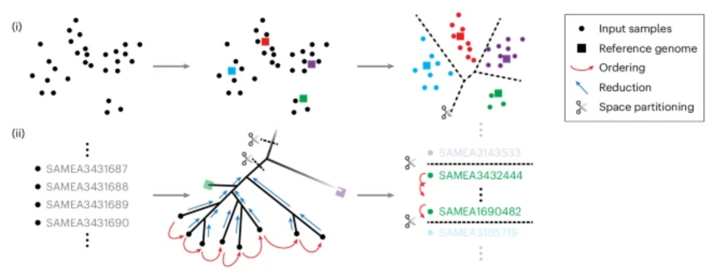
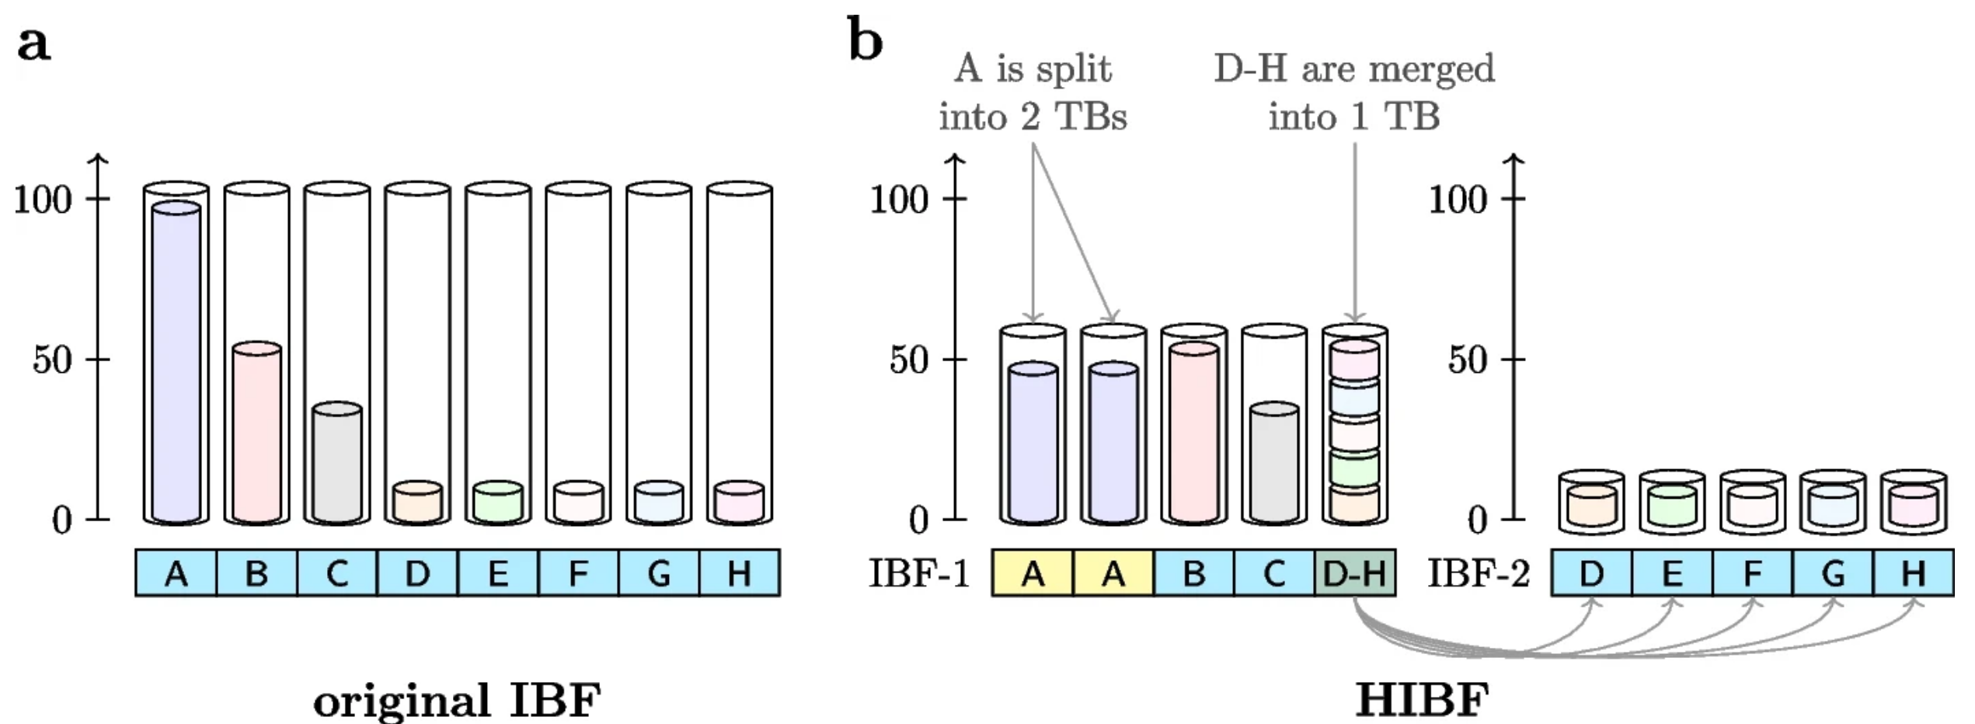
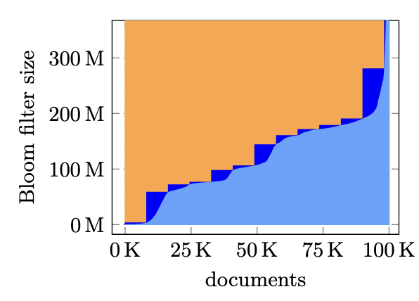
Bin packing and its variants in bioinformatics applications
Phylogenetic Compression:
Groups phylogenetically similar genomes into batches (bins) of equal cardinality.
Hierarchically Structured Bin Packing (DREAM-Yara):
Uses hierarchical taxonomy to group genomes into bins.
Bloom Filter Bin Packing (HIBF):
Groups genomes into a fixed number of Bloom filters of roughly equal size.
Optimizes memory usage and query efficiency
Bin Packing in COBS:
Capacity constraint: fixed maximum false positive rate per bin of equal cardinality.

Slide 50
Bin packing in phylogenetic compression
Data (genomes) split into size-constrained batches (bins).
2 types of bins:
Single-species bins
Multi-species bins i.e. dustbin
2 capacity constraints C
based on bin cardinality (each genome = size 1)
C_{single-species} = 4000
C_{multi-species} = 1000
Collection of genomes
Species clustering/packing
dustbin
First level of phylogenetic compression:
Species-based packing
Followed by within each batch:
phylogenetically reordering + compression using a low-level compressor.

Slide 51


Bin packing in genomes indexing
Key Ideas: Bin packing is used to split data into groups before indexing
HIBF example:
Instead of packing genomes, HIBF packing strategy based on the contents of a set of genomes (A, B, … , H)
Instead of capacity, HIBF uses a limited number of bins (max number of bin allowed)
Packing schemes:
Split the content of a set into several bin
Store the entire content of a set in 1 bin
Store the content of multiple sets, i.e. merging, in 1 bin
COBS example: 100k genomes (documents)
Light blues slope: genomes sorted according to the index sizes (Bloom filter sizes with false positive rate 0.3)
Dark blue staircase: group into bins of 8192 genomes

Slide 52
Bin packing with taxonomy metadata: hierarchically structured bin packing
Input: Tree T with leaves L_{T} (with sizes/weights) and internal nodes N_{T} Bin capacity C
Output: a partion of L_{T} that minimizes overall scatterness.
Scatterness Measure:
Node dispersal number of node v: number of bins intersecting with leaves under v.
Example:
Internal nodes: n1, n2, n3
Leaves: l1 to l9
Leaf size = 1, bin capacity = 3
Partition A:
Dispersal numbers → n1 = 1, n2 = 1, n3 = 1, root = 3
Total scatterness = 6 (optimal)
Partition B:
Dispersal numbers → n1 = 3, n2 = 3, n3 = 3, root = 3
Total scatterness = 9
3/3
r
1/3
n₁
n₂
1/3
n₃
1/3
l₁
l₂
l₃
l₄
l₅
l₇
l₈
l₉
l₆
P_{A: optimal}
P_{B: not optimal}

Slide 53
Bin packing for genomic data recap: generalities and usages
What are the items to pack?
Whole genomes
Genomic contents (k-mers = substrings of length k)
What are some of the capacity thresholds and constraints?
Bin cardinality (number of genomes per bin)
Size of the indexing data structure
Total genomic content (number of distinct k-mers)
Taxonomy or phylogenetic information
What are the applications?
Optimize index space usage (HIBF, COBS)
Group related genomes together (DREAM-Yara, phylogenetic compression)
Enable parallelization (phylogenetic compression)
Improve search efficiency (HIBF, COBS)

Slide 54
Challenge 1: genomes and their contents overlap
In practice, genomic data is highly redundant.
Overlap of contents:
K-mer indexes (e.g. Bloom filters) of multiple genomes can merge its contents
Redundancies can be leveraged:
Phylogenetic compression uses evolutionary history
Improves local redundancy → achieves better compression
Genome 1
ATC
TCG
CTG
TCA
Genome 2
TCA
TGA
CAG
AAA
AAT
Genome 3
AAT
ATC
CCT
AGG

Slide 55
Challenge 2: genomic data is growing extremely fast
As of 2025: Multi-Terabytes Microbial Genome Collections
Computing hardware is not scaling fast enough to keep up
Horizontal scaling through parallelization is necessary
➔ Efficient bin packing is critical to manage and process the data
661k [2]
Nov. 2021
n = 661,405
AllThe Bacteria v0.2 [3]
Mar. 2024
n = 1,932,812 [3]
AllTheBacteria v0.3 [3]
Nov. 2024
n = 2,440,377 [3]
18 Jun 2025: ATB v0.4 with 330k new genomes
Next decade: Even larger collections (n = ~10⁷), higher diversity, …

Slide 56


Finding: Packing genomic data can be formulized as a bin packing with overlapping items problem
Input: A list L of items/sets of symbols Bin capacity C
Output: A partion of L that minimizes the number of bin used; and for each bin b, $\left|\bigcup_{l∈b}{l}\right|≤C$
An extension of the classical bin packing
First proposed in 2011 to used for Virtual Maching Packing
Formalized and some heuristic proposed in 2018
Example: partitioning with items with overlapping contents
Items: {t1, t2, t3, t4}
Contents: {{a,b,c,d,e}, {d,e,f}, {e,f,g}, {h,i,j,k,}}

Slide 57
Optimization problem model

Slide 58


Interger linear model for genomes bin packing with overlapping contents (kmers)
Numberings:
K = {i: i = 1, … , |K|} for the kmers
G = {j: j – 1, … , |G|} for the genomes
B = {b: b $∈Ν$} for the bins
Inputs:
Capacity: C > 0
Assignment of kmer to genome: a_{ij}
$$∀ i∈K, ∀j∈G, a_{ij}=1 if k_{i}∈g_{j}, 0 otherwise$$
Decision variables:
For any $i∈K$, $j∈G$, $b∈B$:
x_{ib} = {0,1} whether kmer i is in bin b
y_{jb} = {0,1} whether genome j is in bin b
z_{b} = {0,1} whether bin b is used
Integer linear program:
$$min. \sum_{b∈B}{z_{b}}$$
s.t:
(1): $\sum_{b∈B}{y_{jb}}=1, ∀ j ∈ G$ ⬄ a genome can be in 1 bin
(2): $z_{b}≥ x_{ib}, ∀i∈K, ∀b∈B$ ⬄ mark bin as used
(3): $\sum_{i∈K}{x_{ib}≤z_{b}C, ∀b∈B}$ ⬄ bin have no more than C kmers
(4): $x_{ib}≥ a_{ij}y_{ib}, ∀ i∈K, ∀ j∈G, ∀ b∈B$ ⬄ if genome’s in a bin, also all of its kmers
Exact solution: Can be solved exact using solver
Impractical in practice due to the scale of data
➔ Heuristic solution needed

Slide 59
Proposition: First fit bin packing with preordering
The Any-Fit (AF) heuristic family (Next-Fit, First-Fit, Best-Fit, …) is well-studied in classical bin packing
In classical bin packing, preordering by item size improves results
Not applicable for genomes → contents may overlap or merge
Proposed approach:
Reorder genomes phylogenetically to optimize for local redundancy
Apply AF heuristics (e.g., First-Fit) on the reordered input
AF
Applications:
Grouping genomes along with its kmers contents for indexing
Grouping genomes for compression

Slide 60
Side proposition: the case of phylogenetic compression’s Dustbin
Recap:
Hierarchically Structured Bin Packing keep take into accounts a tree structure
Phylogenetic compression packs genomes into multi-species bins (dustbin)
Proposition:
➔ Apply HSBP to the case of dustbin.
Collection of genomes
Species clustering/packing
dustbin

Slide 61
Takeaways:
Bin packing is highly relevant in bioinformatics
Optimizes space usage
Facilitates parallelization
Genomes and its contents as items
Packing genomes can be modeled as a bin packing problem
Challenge: items (genomes) may overlap in content
Research proposition
Investigate Any-Fit heuristics (First-Fit, Best-Fit, …) with phylogenetic ordering to exploit local redundancy

Slide 62





Back to a scenario: Max bound on compression size – with ordered input
Inputs:
Given a set of ordered sets of genomes (one for each cluster): {G₁, G₂,…, G_{c}}
For each ordered set $G_{c} =\left\{g_{1},g_{2},…,g_{n}\right\}$
Compression technique: xz(g1+g2+…) with parameters preset from [1]
Goal:
Find a suitable partition of this collection into m batch, while keeping the order:
$$B =\left\{b_{1},b_{2},…,b_{m}\right\}$$
Bin Packing Problem
Decision variables: $x_{ij}∈\{0,1\}, y_{j}∈\{0,1\}$
Objective function:
$$\min\left(\sum_{j=1}^{m}{y_{j}}\right)$$
$$\min\left(\sum_{j=1}^{m}{C_{xz}\left(b_{j}\right)}⋅y_{j}\right)$$
Getting the compression size is expensive
xz compression speed $≈$ 1 genome/sec
1h20m for a batch with n = 5000
Subjects to :
$\sum_{j=1}^{m}{x_{ij}}=1 ∀i∈\{1,…,n\}$ : general constraint
$x_{ij}≤y_{j} ∀i,j$ : general constraint
$C_{xz}\left(b_{j}\right)≤100\left(MB\right)⋅y_{j} ∀j∈\{1,…,m\}$ : bound on compressed size

Slide 63
Hypothesis: prestimation compression size via distinct kmers count

Slide 64
The problem: overlapping kmers of genomes

Slide 65
Bin packing with overlapping items
First proposed in 2011 in VM machine sharing
More formalized and prototype algorithm proposed in 2019 2021 2023
Share similarity with some of other classical optimization problem but not directly applicable
Is an extention of the bin packing problem
Is called pagination problem

Slide 66
Bin packing with overlapping items: definition

Slide 67
Kmers bin packing

Slide 68

Trick: Post compression size approximation using distinct k-mers count at the species level.
Compression Size Vs Distinct Kmers Count – 661k Collections – Top 5 Highly Sampled Species & Dustbin
r = 0.98
r = 0.775
K-mers : length k substring of a genomes
We have to count the number of distinct kmers
K-mers estimation using HyperLogLog sketching
Compression Size (MB)
r = 0.88
r = 0.97
y = 0.269x + 24.481
r = 0.89
r = 0.96
Distinct Kmers Count

Slide 69


Fast Distinct Kmers Counting using sketches
Sketches : approximate data structures
HyperLogLog is used for counting distinct problem
Fast and efficient UNION operation for sketches.

Slide 70
Preliminary experiment: Mycobacterium tuberculosis from 661k collection
Dataset: Mycobacterium tuberculosis from 661k collection
Number of Genomes: 49k – 13 MiniPhy batches
We want the compression size to be approximately 100MB
Using the equation: y = 0.269x + 24.481
Capacity (distinct kmers count) of batches: 279,000,000

Slide 71

Approach: Fist-fit bin packing with distinct kmers count estimation
Input:
A genome order (e.g., accession order, used for comparison to Miniphy).
Steps:
Start with an empty bin.
Iteratively add genomes to the first bin that can accommodate them (based on k-mer threshold).
Estimate distinct k-mer count using Dashing at each step.
Create a new bin if no existing bin can hold the genome.
Implemented at HLL-binning github.com/tam-km-truong/HLL-Binning

Slide 72


Preliminary experiment - Compression size per batch: Binning vs Fixed-Number of genomes (4000)
Size(MB)
Similar total compression size:
1.27GB & 1.24GB
More balanced, but accuracy could be improved
First fit binning
(number of genomes p. batch varies)
Fixed 4000 p. batch

Slide 73


Conclusions
Formulated an optimization problem for Phylogenetic batching
Nextstep:
Both axis: Scale up to AllTheBacteria
Axis 1:
Species-oblivious strategy
Experiments for different parameters (percentage, sketch size)
Axis 2:
Study other estimators of compression size
Other applications: (different constraints, different representation of genomes)

Slide 74


Current outcomes
Poster at the DKM department seminar
Presentation in an internal GenScale meeting
Co-developing MiniPhy2 – released soon
Collaboration: incorporated into the next incremental release of AllTheBacteria

Slide 75



Plans:
Presentation at upcoming SeqBim and DSB conferences
Submit to conferences such as RECOMB and ISMB/ECCB
Eventual Publication in bioinformatics journals e.g. Bioinformatics, Genome Research

Slide 77






